Slide 1
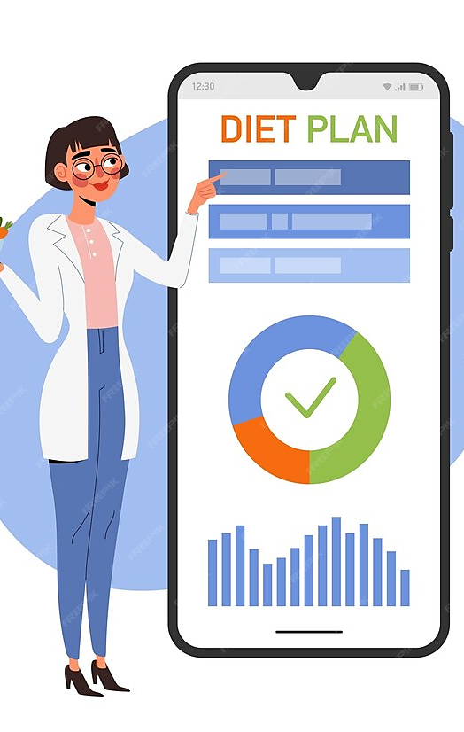

Diet and Workout Recommendation System
Academic Year: 2023-24
Regulation: VR20
Department of Computer Science and Engineering
Section: 4
Batch Number: 6
Guide Name : Dr.S.Naga Mallik Raj

Slide 2
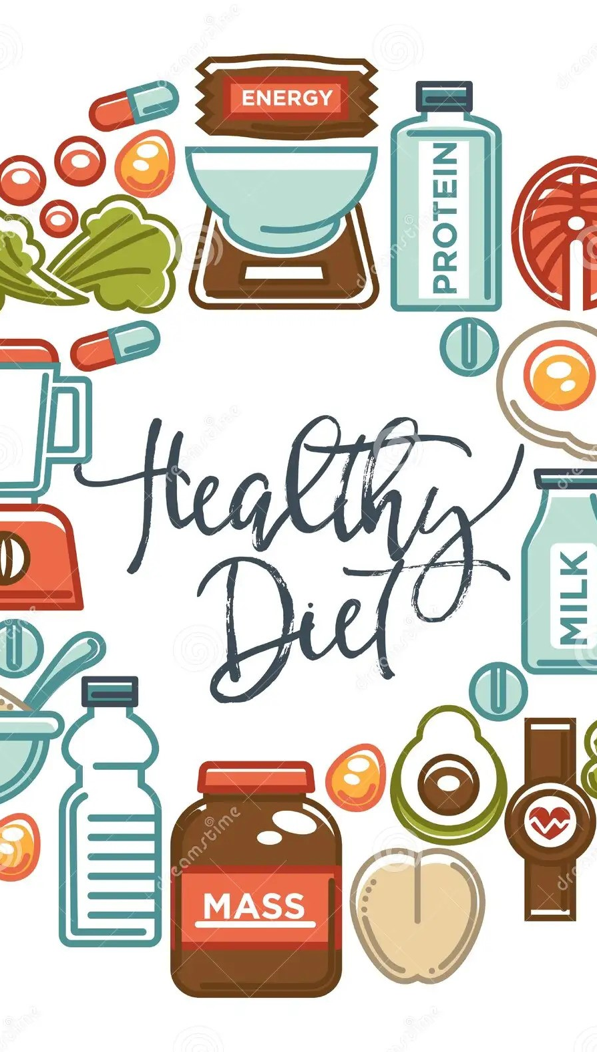
Introduction
This presentation explores the Diet Recommendation System and its use of technology for optimizing health. We will delve into the benefits and challenges of this system, and its potential impact on public health.
Our Diet recommendation engine, using a content-based approach is an important tool for promoting healthy eating habits. This type of engine uses information about the nutritional content and ingredients of foods to make personalized recommendations to users.
This system uses information about the nutritional content and ingredients of foods to make personalized recommendations to users based on individual's dietary restrictions and preferences

Slide 3
Factors Affecting Diet Recommendation
Age and Gender of the Individual
Nutritional Values in the Food Items included
Activity of the Person and Meals per Day
Height and Weight of the Individual
Allergies and
food preferences

Slide 4





Project Analysis
Personal Information Analysis
Analyzing demographic factors like age, gender, weight, and height, considering existing health conditions to tailor dietary recommendations
Dietary Habits Analysis
Evaluating the user's current dietary habits, preferences, and eating patterns and analyzing the intake of macro and micronutrients from the user's diet.
Health Risk Assessment
Identifying health risk factors such as obesity, diabetes, etc., and assessing the risk of nutrient deficiencies based on the user's current dietary intake
Food Preference Analysis
Understanding the user's preferred cuisines and flavors and analyzing any dietary restrictions such as vegetarianism, veganism, gluten intolerance, etc.
Algorithmic Analysis
Utilizing machine learning algorithms to predict the most suitable dietary recommendations based on historical data and user feedback

Slide 5

Technologies Used
Machine learning is a branch of artificial intelligence that allows machines to learn from data and past experiences. It uses algorithms trained on data sets to create models that can perform tasks like analyzing data, categorizing images, and predicting price fluctuations
The recommendation engine is built using the Nearest Neighbors algorithm which is an unsupervised learner for implementing neighbor searches. It acts as a uniform interface to three different nearest neighbors algorithms: BallTree, KDTree, and a brute-force algorithm based on routines in sklearn

Slide 6


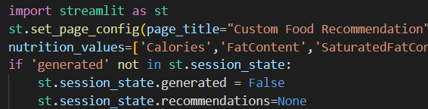
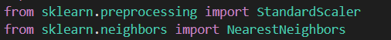
Technologies used
Streamlit is an open-source app framework in Python language. It helps to create web apps for machine learning in a short time. It is compatible with major Python libraries such as scikit-learn.
Scikit-learn is a popular machine-learning library for the Python programming language. It provides simple and efficient tools for data analysis and modeling, including various machine-learning algorithms for classification, regression, clustering, dimensionality reduction, and more.

Slide 7


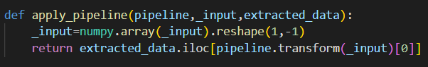
Technologies used
NumPy is an open-source project that enables numerical computing with Python, created in 2005 consisting of Numeric and Numarray libraries. NumPy will always be 100% open-source software and free for all to use.
Pandas is an open-source data manipulation and analysis library for the Python programming language. It provides easy-to-use data structures, such as Series and DataFrame, along with a variety of functions to manipulate and analyze structured data

Slide 8
System Overview
The "Diet and Workout Recommendation System" uses Machine Learning to analyze individual data and provide personalized guidance for weight loss and for improving health and fitness
The existing systems provide food content-based recommendations and user-based recommendations using graph clustering and deep learning however these systems do not consider factors like individuals’ age, gender, location, etc. The proposed system uses Python-based ML models to incorporate user information (e.g., gender, age, location) into the diet recommendation framework, improving overall performance.

Slide 9
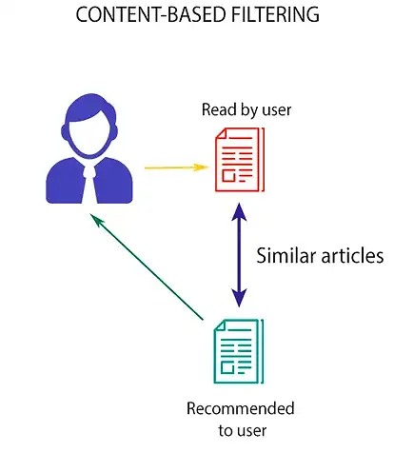
Working process

Slide 10
Content-Based Filtering
A content-based recommendation engine is a type of recommendation system that uses the characteristics or content of an item to recommend similar items to users. It works by analyzing the content of items, such as text, images, or audio, and identifying patterns or features that are associated with certain items. These patterns or features are then used to compare items and recommend similar ones to users.
Why content-based approach?
No data from other users is required to start making recommendations.
Recommendations are highly relevant to the user.
Recommendations are transparent to the user.
You avoid the “cold start” problem.
Content-based filtering systems are generally easier to create.

Slide 11
Methodology of System Designed
The system provides recipe recommendations based on user-provided nutrition information and ingredients implemented with FastAPI for the backend and utilizing several utility functions defined in a separate module called model.py. Here's a breakdown of the system's components and functionality:
The main.py file initializes the FastAPI server, defining routes for health checks and recipe predictions. It utilizes Pydantic models (‘params’, ‘PredictionIn’, Recipe,’ ‘PredictionOut’) for input and output validation.
The model.py defines functions for performing recipe recommendations based on user-provided data, it provides functions for data preprocessing, including scaling and utilizes sklearn's NearestNeighbors algorithm for finding similar, defines utility functions for building recommendation pipelines, filtering data based on ingredients, and formatting output.
These functions handle processing input data, preprocessing nutritional information, filtering recipes, applying recommendation pipeline, and formatting output.

Slide 12
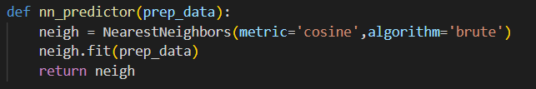
Algorithm Implementation
The nn_predictor() function in the project code implements the k-Nearest Neighbors (k-NN) algorithm using the NearestNeighbors class from the sklearn.neighbors module. The k-NN algorithm is an instance-based learning algorithm used for classification and regression tasks. In this case, it is used for finding the k-nearest neighbors of a given point in a high-dimensional space based on a specified distance metric.
The 'cosine' metric is a distance metric used in KNN algorithms that measures the cosine of the angle between the two vectors, providing a measure of similarity irrespective of their magnitudes. In the context of KNN, a smaller cosine distance indicates greater similarity between samples. Here, the 'brute' algorithm is used, which computes the nearest neighbors by brute force, comparing all pairs of points.
The neigh.fit() method is called with the preprocessed data as input. The ‘fit’ method trains the NearestNeighbors instance on the input data. In this case, it computes the distances between all pairs of points in the preprocessed data and stores the necessary information for finding the nearest neighbors.

Slide 13
Advantages
Adaptability
As users progress in their fitness journey or encounter changes in their lifestyle, the recommendation system can adapt and modify suggestions accordingly. This adaptability ensures that the advice remains relevant and effective over time
Health Monitoring
Machine learning can help monitor health parameters and adjust recommendations accordingly. For example, if a user has a medical, the system can adapt the recommendations to ensure they align with the user's current health requirements.
Nutritional Guidance
Machine learning algorithms can analyze nutritional content, preferences, and dietary restrictions to offer personalized meal plans. This ensures that users receive recommendations that align with their nutritional needs and preferences.
Cost-Effective
For users who may not be able to afford personal trainers or nutritionists, an ML-based system offers a cost-effective alternative for receiving personalized guidance and support in achieving health and fitness goals.

Slide 14
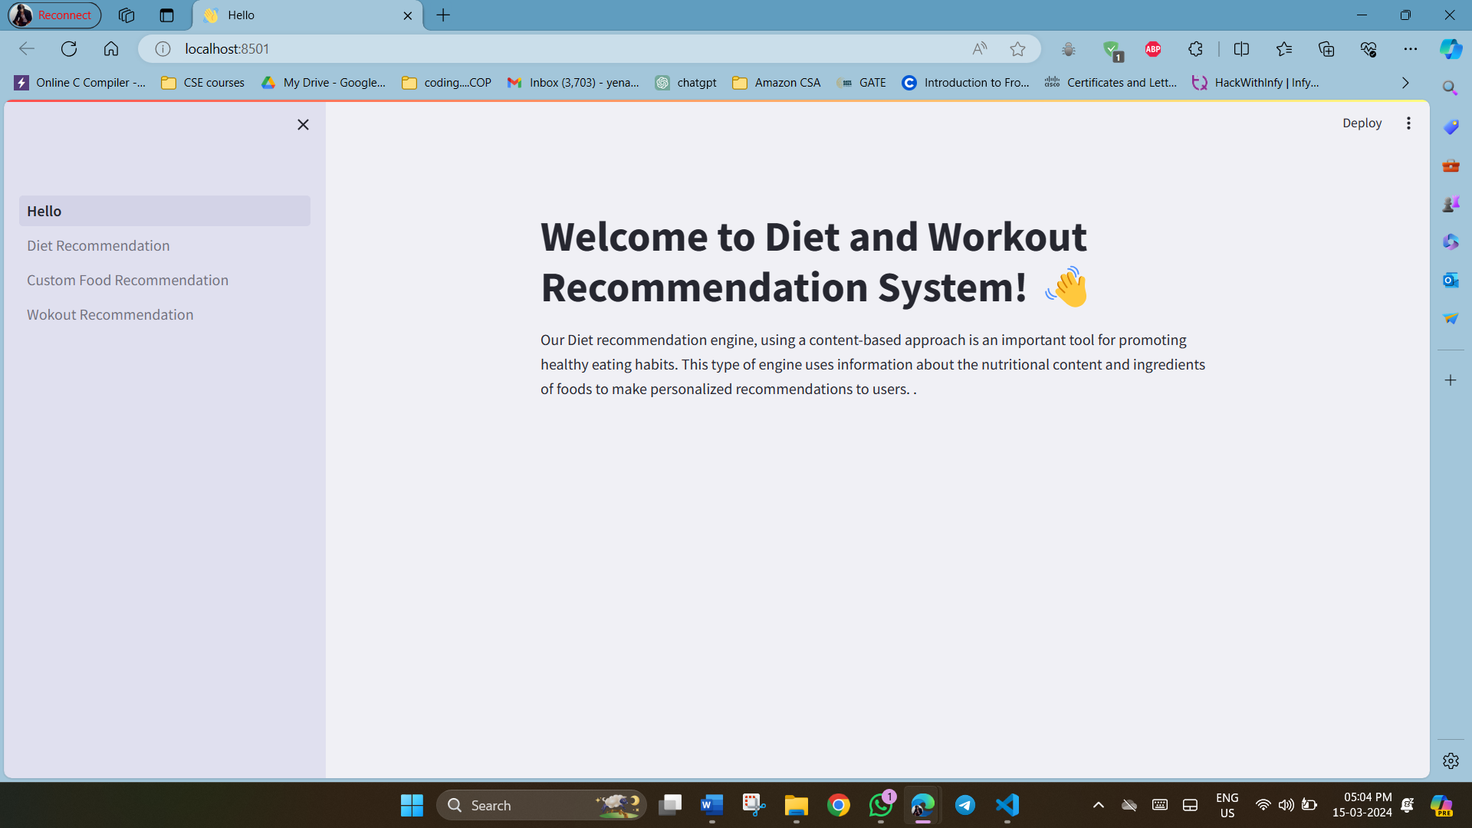
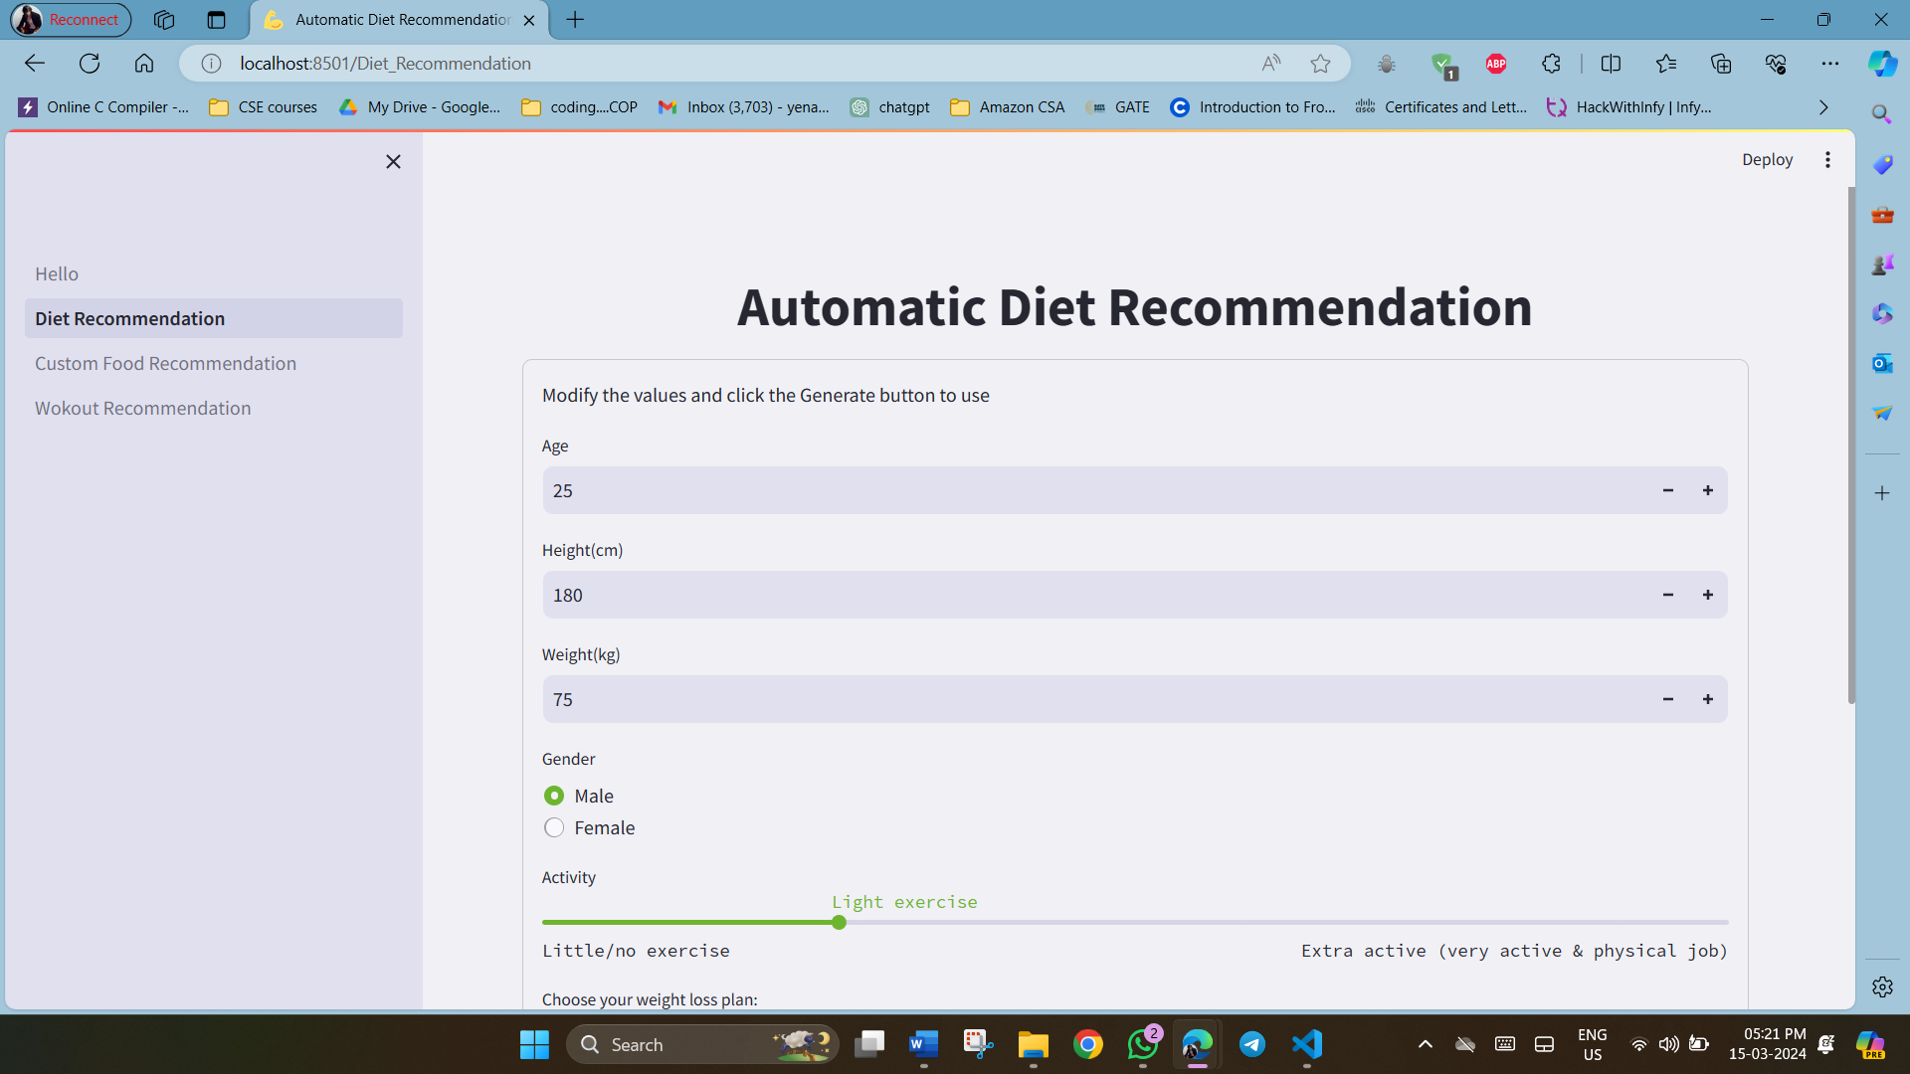
Output Screens
Fig. 1. Home Page
Fig. 2. Automatic Diet Recommendation input page1

Slide 15
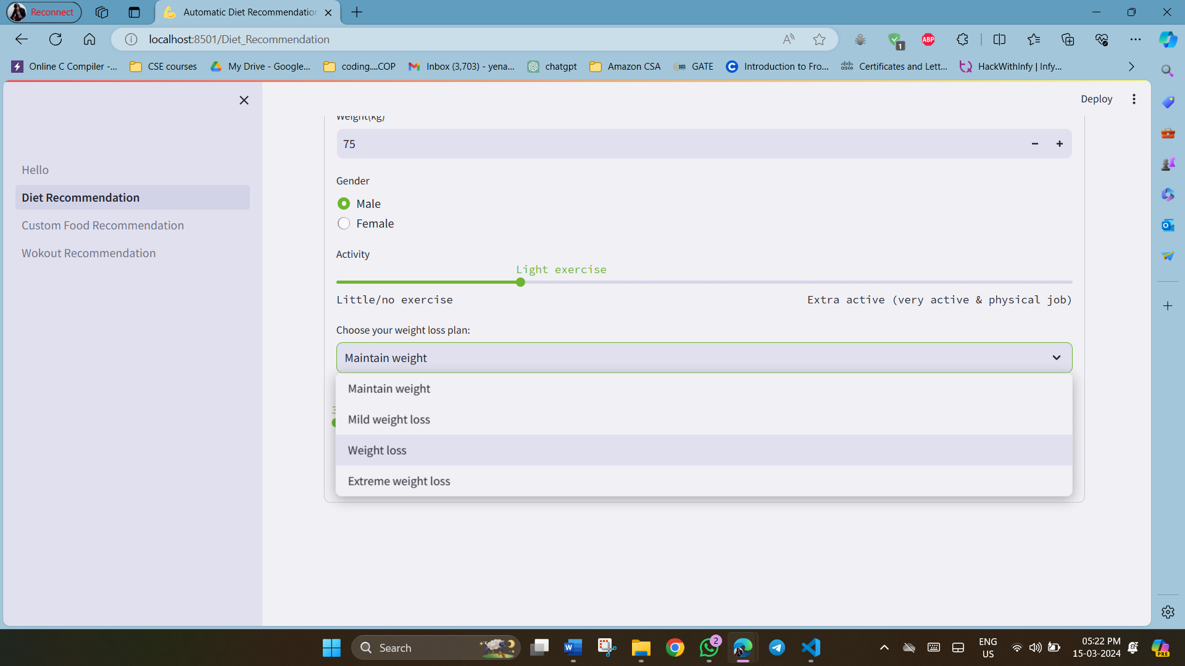
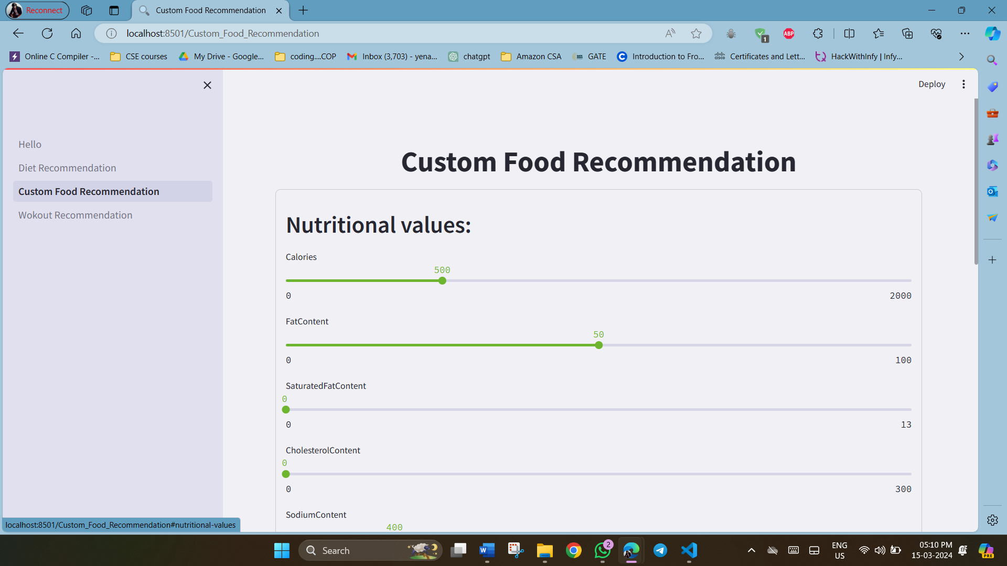
Output Screens
Fig. 3. Automatic Diet Recommendation input page2
Fig. 4. Custom Food Recommendation input Page1

Slide 16
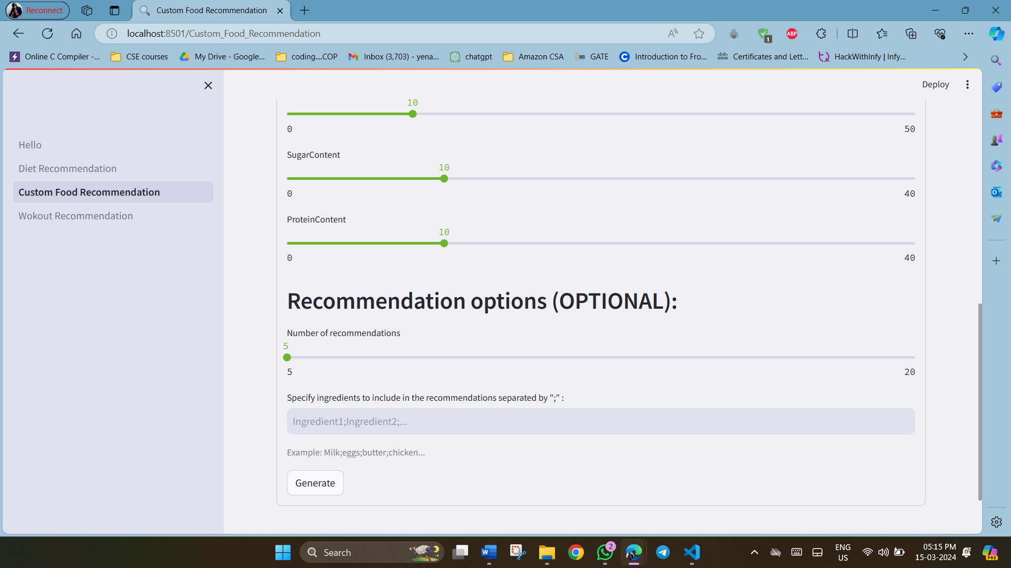
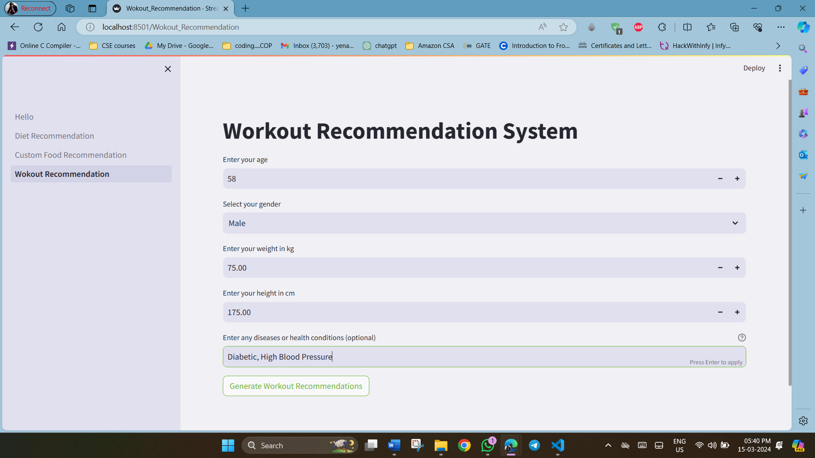
Output Screens
Fig. 5. Custom Food Recommendation input page2
Fig. 6. Workout Recommendation Input page

Slide 17
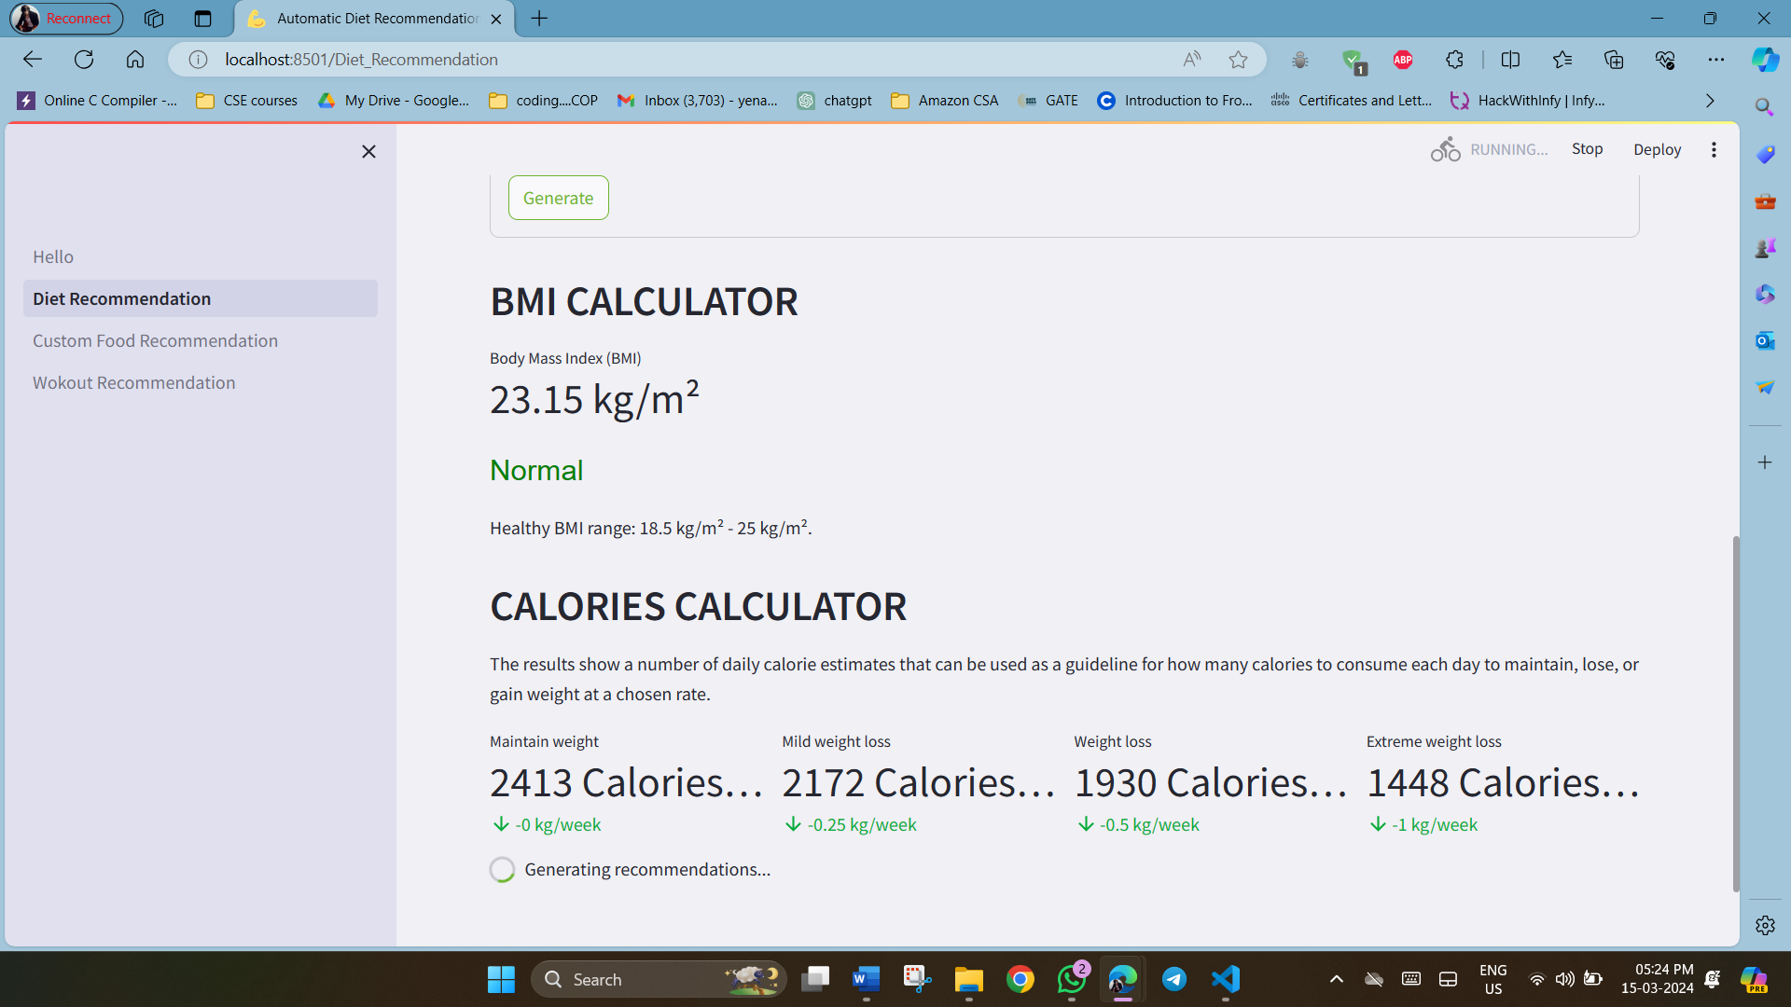
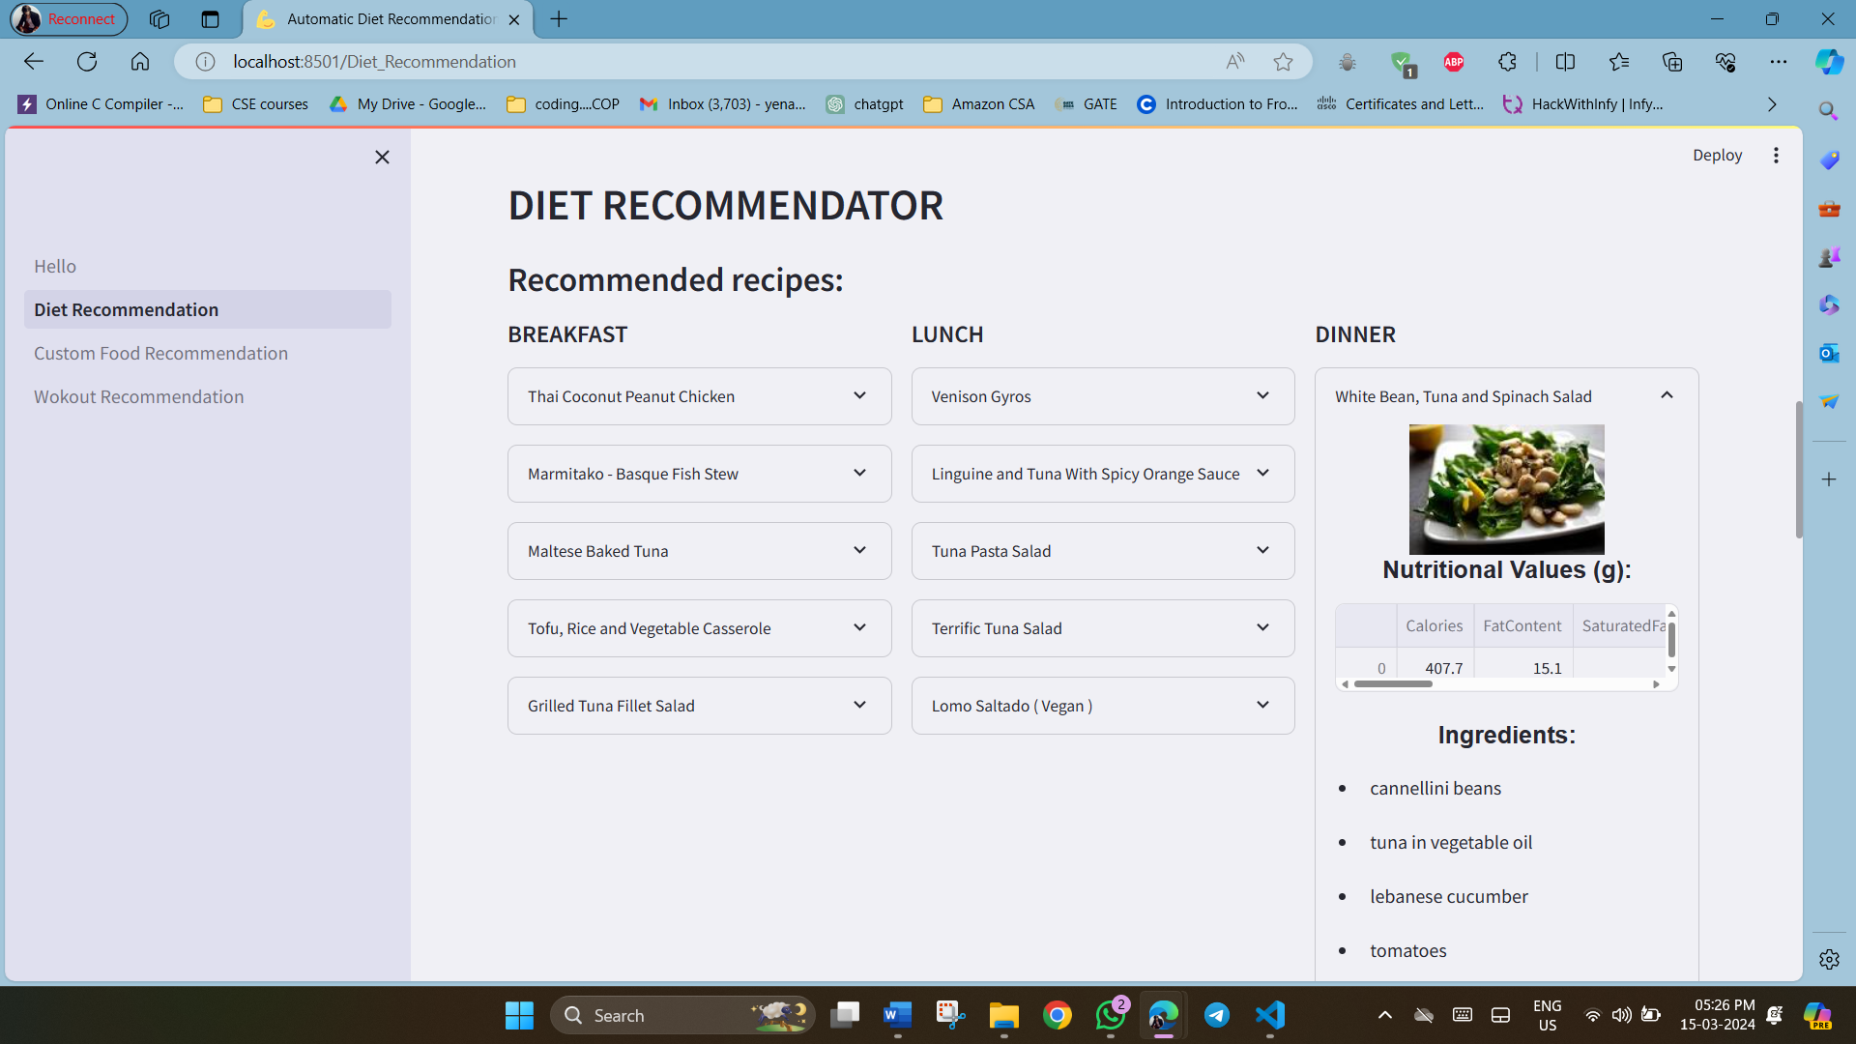
Output Screens
Fig. 7. BMI and Calorie Calculator Page
Fig. 8. Recommended Diets Page with detailed Recipe values

Slide 18
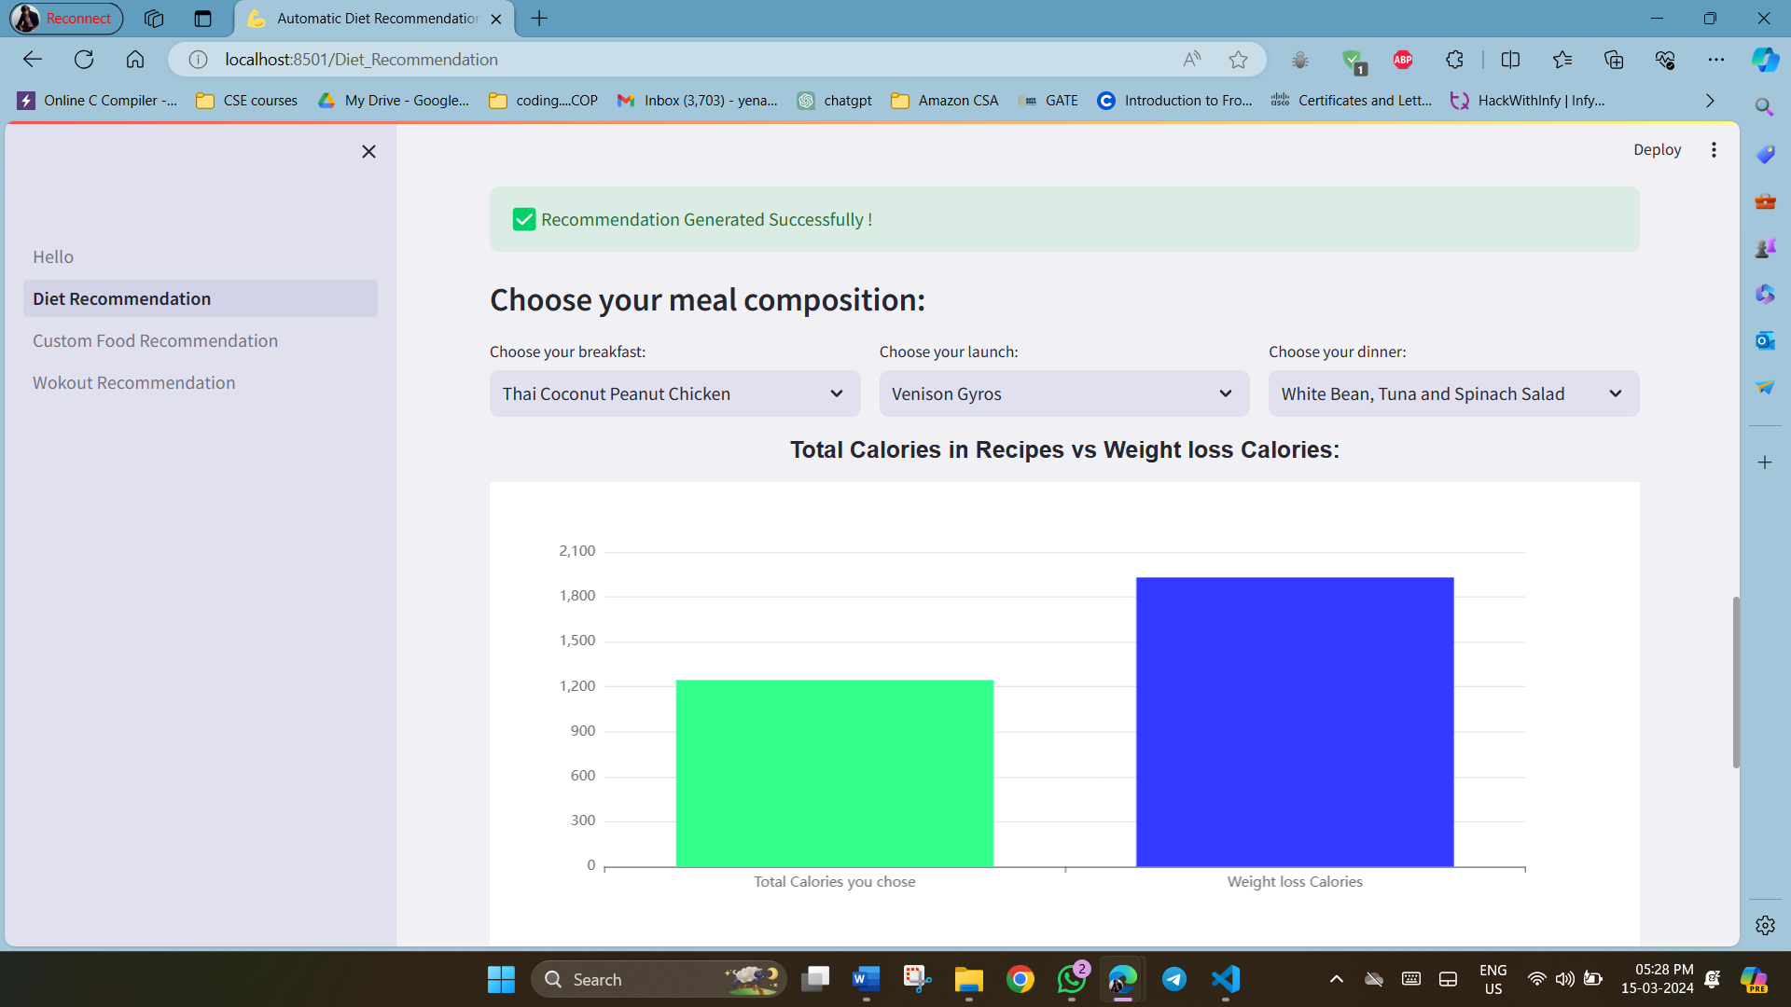
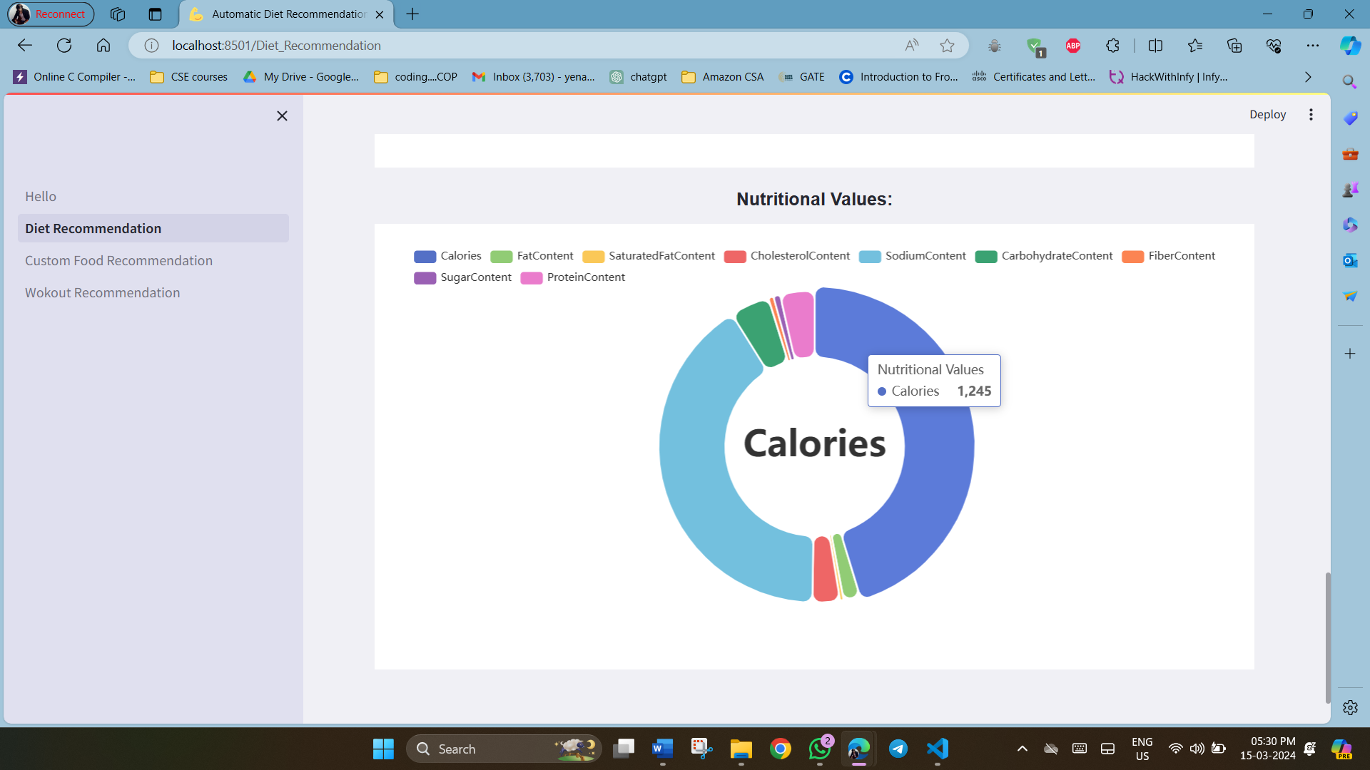
Output Screens
Fig. 9. Meal composition comparison graph
Fig. 10. Nutritional Values Pie chart

Slide 19
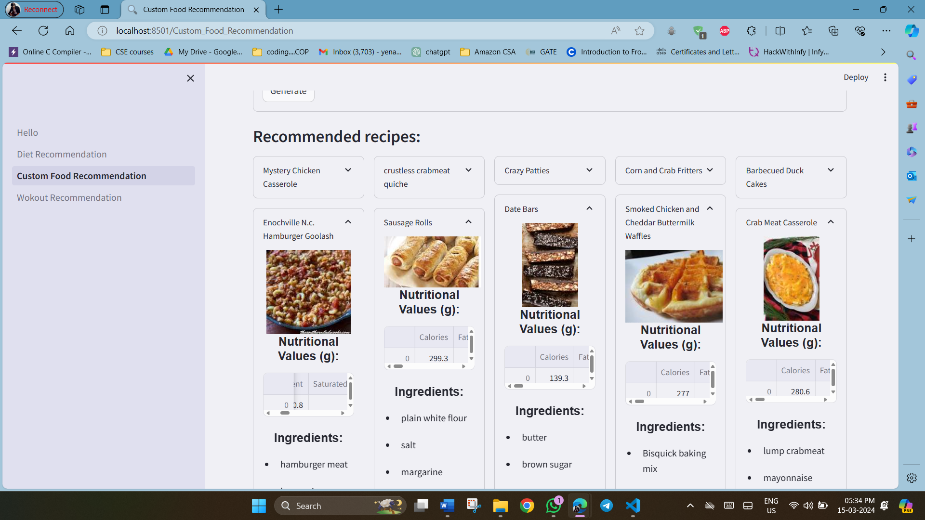
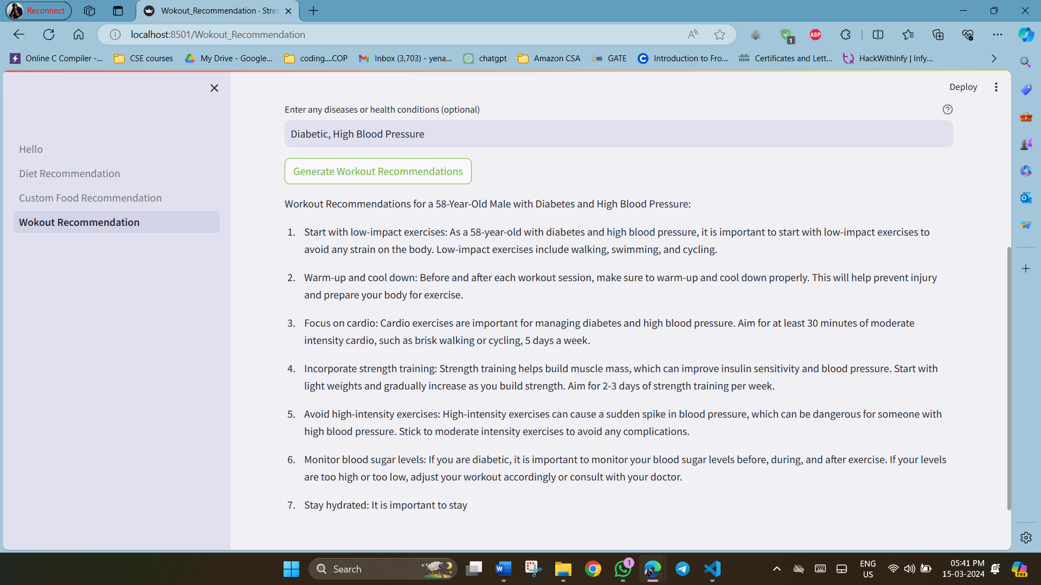
Output Screens
Fig. 11. Recommended recipes for customized nutritional values
Fig. 12. Generated Workout Recommendations

Slide 20
Conclusion & Future Scope
Conclusion
Future Scope
The major project " Diet and Workout Recommendation System using Nearest Neighbors" represents a significant advancement in addressing the growing demand for personalized health and wellness solutions. By integrating Streamlit for the frontend user interface and the Nearest Neighbors machine learning algorithm, we have developed a system that offers tailored recommendations to individuals based on their unique needs and preferences. Our research and development efforts have highlighted the potential of machine learning algorithms in analyzing user data and generating personalized recommendations.
The project's vision extends beyond its current implementation, encompassing various avenues for future enhancement. These include the integration of advanced machine learning techniques such as deep learning for more accurate predictions and personalized recommendations. The development of a mobile application will enhance accessibility and user engagement. Furthermore, collaboration with health professionals and fitness experts will ensure that the recommendations align with established guidelines and best practices. Continuous model training and updates will also be implemented to adapt to evolving user preferences and health trends.

Slide 21
References
Subramaniyaswamy, V.., Manogaran, Gunasekaran., Logesh, R.., Vijayakumar, V.., Chilamkurti, N.., Malathi, D.., & Senthilselvan, N.. (2018). An ontology-driven personalized food recommendation in IoT-based healthcare system. The Journal of Supercomputing , 75 , 3184 - 3216 . http://doi.org/10.1007/s11227-018-2331-8
Raggatt, Michelle., Wright, C.., Carrotte, E.., Jenkinson, R.., Mulgrew, K.., Prichard, I.., & Lim, M.. (2018). “I aspire to look and feel healthy like the posts convey”: engagement with fitness inspiration on social media and perceptions of its influence on health and wellbeing. BMC Public Health , 18 . http://doi.org/10.1186/s12889-018-5930-7
Burke, L.., Castell, L.., Casa, D.., Close, G.., Costa, R.., Desbrow, B.., Halson, S.., Lis, D.., Melin, A.., Peeling, P.., Saunders, P.., Slater, G.., Sygo, J.., Witard, O.., Bermon, S.., & Stellingwerff, T.. (2019). International Association of Athletics Federations Consensus Statement 2019: Nutrition for Athletics.. International journal of sport nutrition and exercise metabolism , 29 2 , 73-84 . http://doi.org/10.1123/ijsnem.2019-0065
Grgic J, Grgic I, Del Coso J, Schoenfeld BJ, Pedisic Z. Effects of sodium bicarbonate supplementation on exercise performance: an umbrella review. J Int Soc Sports Nutr. 2021 Nov 18;18(1):71. doi: 10.1186/s12970- 021-00469-7. PMID: 34794476; PMCID: PMC8600864
Schmitz KH, Troxel AB, Dean LT, DeMichele A, Brown JC, Sturgeon K, Zhang Z, Evangelisti M, Spinelli B, Kallan MJ, Denlinger C, Cheville A, Winkels RM, Chodosh L, Sarwer DB. Effect of Home-Based Exercise and Weight Loss Programs on Breast Cancer-Related Lymphedema Outcomes Among Overweight Breast Cancer Survivors: The WISER Survivor Randomized Clinical Trial. JAMA Oncol. 2019 Nov 1;5(11):1605- 1613. doi: 10.1001/jamaoncol.2019.2109. PMID: 31415063; PMCID: PMC6696732.
Doppala BP, Naga Mallik Raj S, Stephen Neal Joshua E, Thirupathi Rao N (2021) Automatic determination of harassment in social network using machine learning. https://doi.org/10.1007/978-981-16-1773-7 20
NagaMallik Raj, S., Neeraja, S., Thirupathi Rao, N., Bhattacharyya, D. (2023). Multitask Deep Learning Model for Diagnosis and Prognosis of the COVID-19 Using Threshold-Based Segmentation with U-NET and SegNet Classifiers. In: Sisodia, D.S., Garg, L., Pachori, R.B. Tanveer, M. (eds) Machine Intelligence Techniques for Data Analysis and Signal Processing. Lecture Notes in Electricall Engineering, vol 997. Springer, Singapore. https://doi.org/10.1007/978-981-99-0085-5 19

Slide 22

Y.S.S.S.R.Prabhakar 20L31A05P4
T.Sai Manohar 20L31A05N2
T.Prem Kumar Naidu 20L31A05N0
P.Keerthi Priya 20L31A05P7
R.Tejaswini 20L31A05K3

